Slide 1
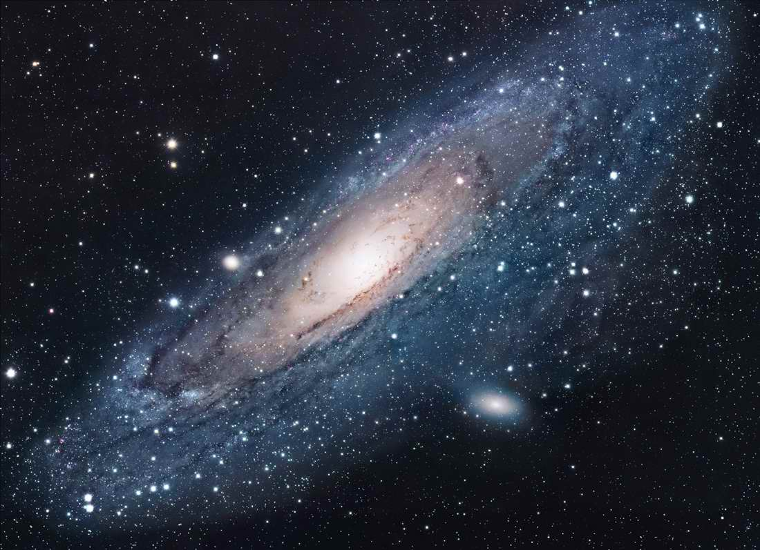
Astrophysics Taking Physics to the Stars

Slide 2
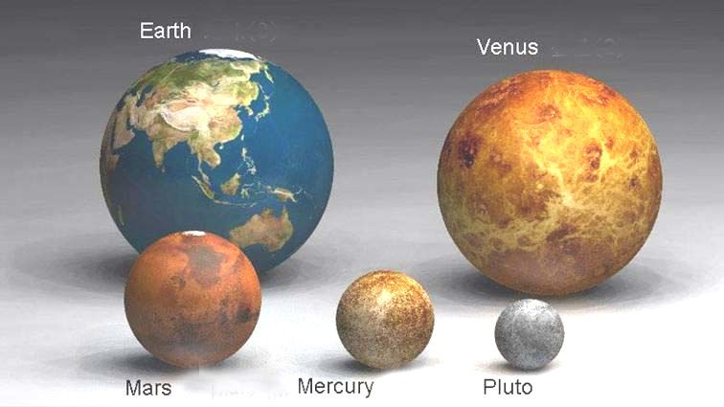
Scale of the Universe

Slide 3
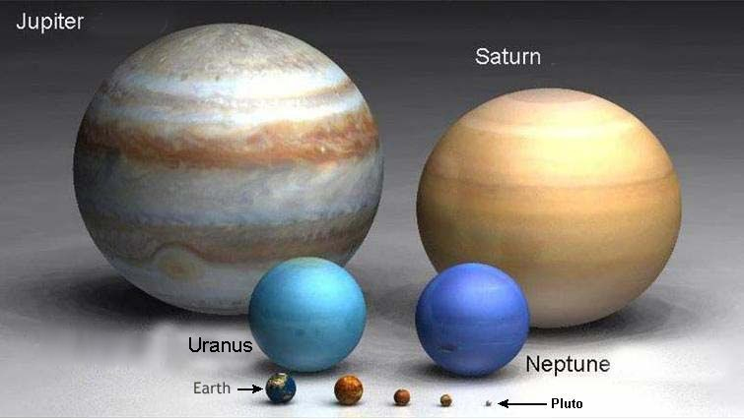
Scale of the Universe

Slide 4
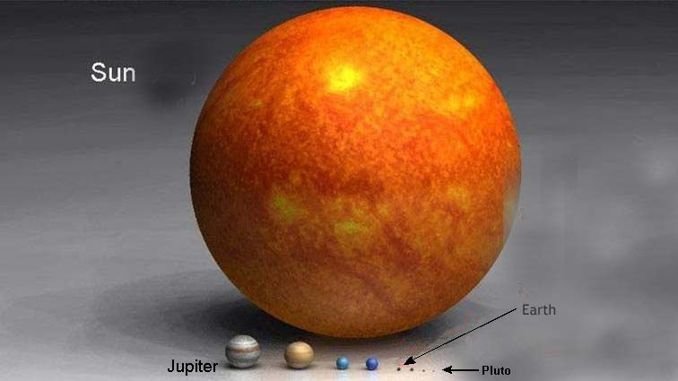
Scale of the Universe

Slide 5
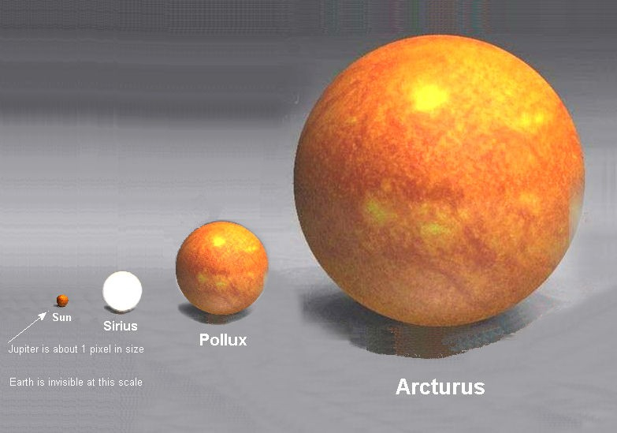
Scale of the Universe

Slide 6
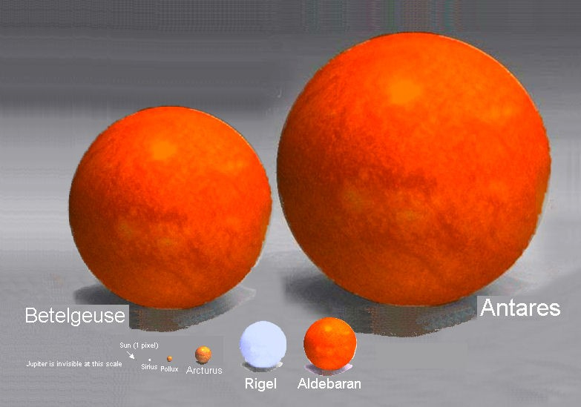
Scale of the Universe

Slide 7
Distances in Astronomy
Units of Light
Light year: A light year is the distance travelled by light in one year which is exactly 9,460,730,472,580.8 km. It is based on exactly 365.25 days each with exactly 86,400 seconds (31,557,600 seconds in total) and defined as the speed of light of exactly 299,792,458 m s⁻¹.
For ease of calculations, one light year = 9.46 x 10¹⁵ m as shown below.
s = vt
= 299 792 458 x 365.25 x 86 400
= 9.46 x 10¹⁵ m or 9.46 x 10¹² km
A Light minute is the time light will travel in one minutes while a light hour is the time light travels in one hour. Using the ideas above, you can calculate the distance travelled by a light minute and a light hour. The light month is not precise so is not used.

Slide 8
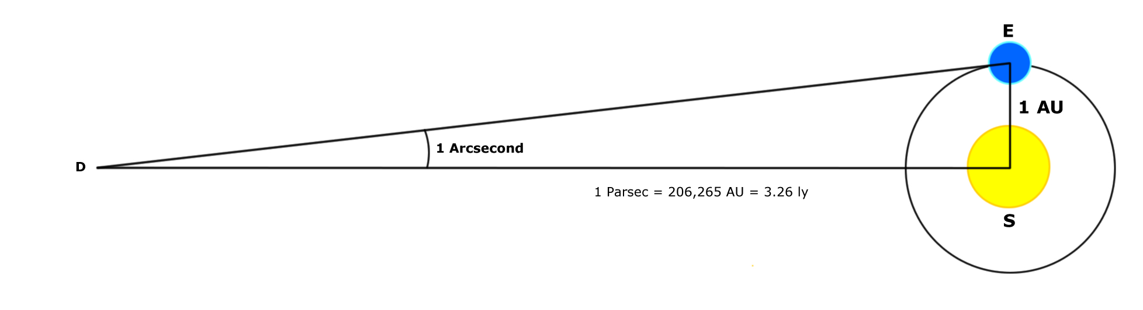
Other Scales in Astronomy
1 Astronomical unit (Au) is the distance between the Earth and the Sun. It is of use only when discussing distances within our solar system. Beyond that it is far too small a unit to be of use.
Parsec: A parsec (pc) is a unit of length used in astronomy equal to about 10¹² km or about 3.26 light years.
A megaparsec is 10¹⁸ km which is the common unit for measuring distances between galaxies. E.g the Andromeda Galaxy is 0.77 Mpc from the Earth.
The Parsec is the distance at which 1 AU subtends and angle of 1 arcsec (the parallax) as shown below.
1 Arc second is an angle of 1/3600th of a degree.

Slide 9



Parsecs in Science Fiction
“You’ve never heard of the Millennium Falcon? …
It’s the ship that made the Kessel run in less than 12 parsecs.”

Slide 10
Calculations using the speed of light
The distance to Alpha Centauri A & B is roughly 4.35 light years. Calculate this in kilometres and parsecs.
Kilometres: 1 light year = 9.46 x 10¹² km
distance to Alpha Centaui = 9.46 x 10¹² x 4.35
= 4.12 x 10¹³ km
parsecs: 1 pc = 3.26 light years
distance = 4.35 / 3.26
= 1.33 pc

Slide 11
Waves
Light and sound are both propagating waves.
As they move towards an observer the number of crests that reach the observer in a second is called the frequency of that wave.

Slide 12
The Doppler Effect
You probably have at some time observed the Doppler Effect.
An ambulance with its siren sounding as it passes is an example of this phenomenon.
As the ambulance comes towards you, the pitch of its siren is higher than when it passes by. As it passes, the pitch of the siren drops significantly – sometimes as much as two whole notes on the musical scale.
Waiting at a level crossing in a car, you will also notice the Doppler Effect in action. The whistle on a fast moving train sounds markedly higher as the train approaches a level crossing than it does as the train is receding.
But Why? And what does this have to do with Astronomy?

Slide 13

Resting sound source
Frequency f_{s}
V=340m/s
Frequency f_{o}
source
at rest
observer
at rest

Slide 14
Sound source moving toward observer
Observer hears
increased pitch
(shorter wave length)
Frequency f_{o}
Frequency f_{s}
source
observer
at rest

Slide 15

Sound source moving away from observer
Observer hears
decreased pitch
(longer wave length)
Frequency f_{o}
Frequency f_{s}
observer
at rest
source

Slide 16
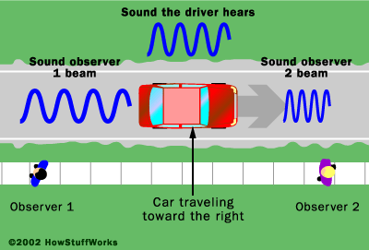
Observed frequency
where: f_{s} = frequency of the source (Hz)
f₀ = frequency heard by observer (Hz)
V = velocity of sound (m s⁻¹)
v_{s} = velocity of source (m s⁻¹)
v₀ = velocity of observer (m s⁻¹)
Source toward observer:
Increased frequency
Source away from observer:
Decreased frequency
where: f_{s} = frequency of the source (Hz) f₀ = frequency heard by observer (Hz)
V = velocity of sound (m s⁻¹)
v_{s} = velocity of source (m s⁻¹)
v₀ = velocity of observer (m s⁻¹)

Slide 17
Light is an electromagnetic wave
Light consists of fluctuations in, or waves of the electromagnetic field.
The wavelength (or distance from one wave crest to the next wave crest) of light is extremely small — for visible light it ranges from four to seven ten millionths of a metre (400nm – 700nm).
The frequency is very high measured in millions of Hertz.
Red light has a low frequency compared to blue light.

Slide 18
Colours
The different wavelengths of light are what the human eye sees as different colours because they are sensed in different proportions by the cones.
The longest wavelengths appear in the red end of the spectrum and the shortest appear in the blue end.
The lowest frequencies appear in the red end of the spectrum and the highest appear in the blue end.

Slide 19
Doppler Effect with Light
Just as sound waves are ‘bunched up’ or spread out – so are light waves!
We perceive sound as pitch differences and light as colour differences.
Low frequency visible light is red
High frequency visible light is blue

Slide 20
Source Movement
The fact that a star, or any light source, is moving toward or away from you does not affect the frequency at which it emits light – but it does affect how you (as the observer) perceive it emitting that light.

Slide 21
Stationary Source
Imagine a source of light at a constant distance from us, emitting waves of light at a constant wavelength.
Obviously, the wavelength of the waves we receive will be the same constant wavelength at which they are emitted by the source.

Slide 22
Source Moves Away From Us
Similarly, if the source is moving away from us, the frequency of the waves will appear slightly lower, or shifted toward the red end of the spectrum.
This is because the source will have moved a bit before it emits the next wave front that travels towards us – that one will therefore have further to travel.

Slide 23
Source Moves Towards You
Suppose now that the source starts moving directly toward us.
When the source emits the next wave crest, it will be nearer to us, so the distance we will see between the two wave crests arriving will appear to be smaller than when the star was stationary.
This means that the frequency of the waves we receive will be higher (or shifted toward the blue end of the spectrum) than when the source was not moving.

Slide 24
Red Shift and Blue Shift
The apparent shift of light is toward the red occurs when the emission source is moving away from us
It is toward the blue when the emitter is moving toward us.
This is called the Doppler Shift or Red Shift Effect.

Slide 25
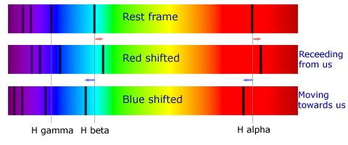
Red Shift and Blue Shift

Slide 26
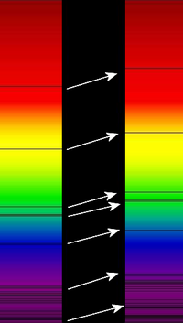
Implication of Redshift
ALL stars display redshift – none ‘blueshift’ . (as a whole).
Therefore all stars are moving away from us.
This means that the Universe is expanding!
Redshift is evidence of an expanding Universe!

Slide 27
Observing Light From Stars
The light from distant stars and more distant galaxies is a mixture of colours.
Each colour has its own frequency.
A star has its own distinct ‘spectrum’ – colours that make up its light.
The light emitted from a star is characteristic of the atoms in the gases around that star.

Slide 28
Emmision Spectra
An emission spectrum consists only of radiation at a number of discrete wavelengths, appearing as bright lines against a dark background.
This type of spectrum is produced by hot diffuse gases, such as in a gas discharge tube or in clouds of interstellar gas heated by hot young stars nearby.
Electrical energy or heat supplied to the gas is absorbed by atoms or ions in the gas, raising the energy level of electrons.
As the electrons fall back to their normal energy state, they give up a quantum of energy as a photon corresponding to one of the observed wavelengths.
The emission spectrum is made up of lines corresponding to all the possible electron transitions. The relative intensity of each line depends on the composition of the gas.

Slide 29
Line Abosrption Spectra
An absorption spectrum consists of a continuous range of wavelengths with discrete gaps at particular wavelengths, appearing as dark lines against a continuous background of colours.
Absorption spectra are produced when a continuous spectrum of light passes through a cloud of cool gas.
Atoms and ions in the gas absorb photons of wavelengths corresponding to the quanta of energy involved in possible transitions of electrons to higher energy levels.
The electrons quickly fall back to their original energy level, re-emitting the absorbed wavelength in all directions, thus reducing the intensity of light transmitted at the corresponding wavelengths.
These wavelengths correspond to the dark lines of the absorption spectrum.
The relative darkness of each line depends on the composition of the gas. The darkness of the lines against the background spectrum depends on the size and density of the cloud of gas.

Slide 30


Spectra
As you know, each element emits a certain ‘set’ of frequencies of light when excited. They are like fingerprints for that element.
The black lines in the spectrum above show the ‘fingerprint’ spectrum for helium.
This is an example of LINE ABSORPTION
It can also be shown as a series of coloured lines

Slide 31
Continuous Black Body Spectra
A continuous black body spectrum has no lines, either dark or bright, but instead shows a continuous range of frequencies.
Continuous spectra are given off by hot solids, liquids and high pressure gases.
The intensity of the spectrum varies smoothly with frequency, with a maximum that depends on the temperature of the body.

Slide 32
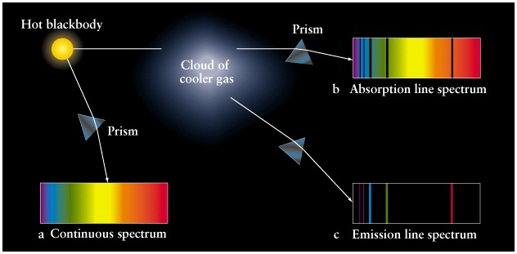
Emission and Absorption Spectra

Slide 33
Spectra Summary
Continuous black body spectrum | Emission spectrum | Absorption spectrum
consists of a continuous range of frequencies without either bright or dark lines, appearing as a continuous range of colours | consists only of radiation at a number of discrete wavelengths, appearing as bright lines against a dark background | consists of a continuous range of wavelengths with discrete gaps at particular wavelengths, appearing as dark lines against a continuous background of colours
given off by hot solids, liquids and high pressure gases | produced by hot diffuse gases | produced when a continuous spectrum of light passes through a cloud of cool gas
all wavelengths are produced at some intensity | wavelengths produced depend on possible energy transitions within atoms of the gas | wavelengths absorbed depend on possible energy transitions within atoms of the gas
intensity varies smoothly with wavelength, with the maximum depending on the temperature of the hot body. | intensity of lines varies discretely with each wavelength, depending on the composition of the gas | darkness of lines varies discretely with each wavelength, depending on the composition and density of the gas

